Slide 1

Phone movement identity verification method
The innovative identity verification method

Slide 2
HIGHLIGHTING BENEFITS
FAST
COMFORTABLE
CAMOUFLAGE

Slide 3

FAST
PROBLEMS
Some people such as firefighter need speed or their will be many loss

Slide 4
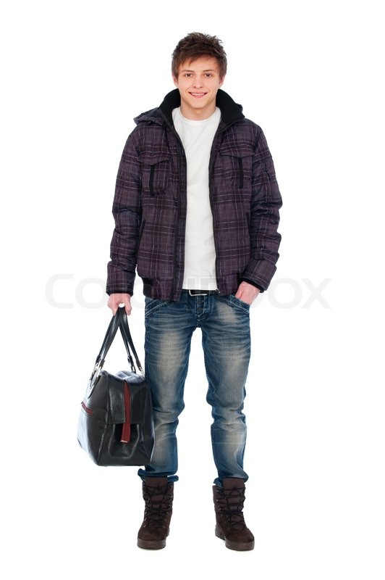
COMFORTABLE
PROBLEMS
For example, when you holding bags you will find it hard to enter pin.
But you can still move your phone

Slide 5
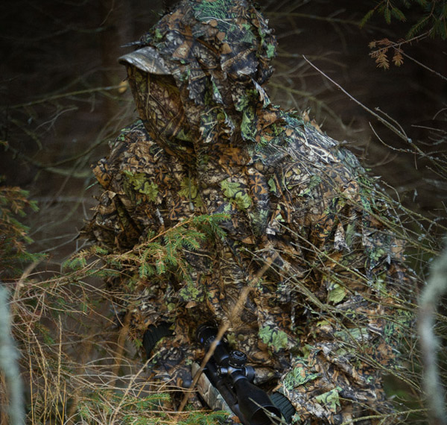
CAMOUFLAGE
PROBLEMS
If you are important (or rich) person some professional spies might spy on you.
Camouflage help make spies spy harder.

Slide 6
FEATURES
DETECT MOVEMENT/ROTATION IN THREE AXIS
DETECT MORE COMPLEX PATTERN
DETECT WHEN MOVING WITH BUSY HAND (CAMOUFLAGE)

Slide 7
SHOW TIME

Slide 8

DO YOU SEE WHAT IS THE PATTERN USED TO VERIFY ?

Slide 9
IS IT HARD TO SEE THE PATTERN USED TO VERIFY ?
THIS MEAN THAT PHONE MOVEMENT VALIDATION SOLUTION IS SECURE TO SPYING

Slide 10
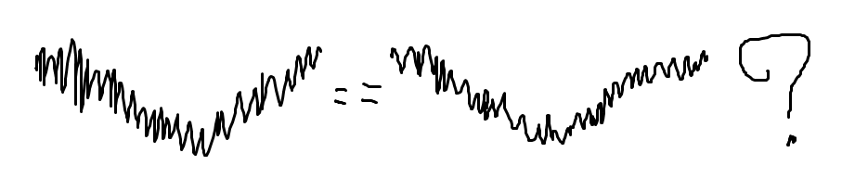
OUR ALGORITHM FIRST TRY: EXACT MATCH
Human see it almost equal
Mobile (Computer) see it completely difference

Slide 11
OUR ALGORITHM SECOND TRY: COMPUTE ERROR
And then find mean of error
And check if mean of error not exceeding limit.
Accuracy not high enough

Slide 12
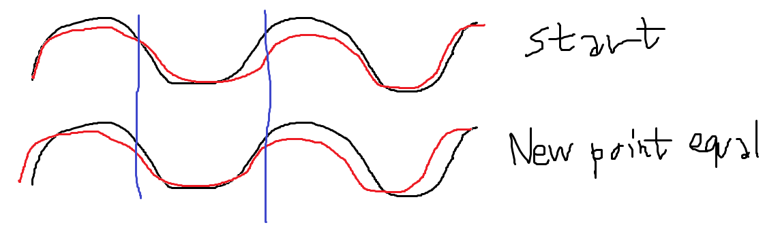
OUR ALGORITHM FINAL TRY: MOVE ALONG AXIS X

Slide 13
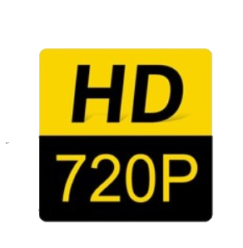
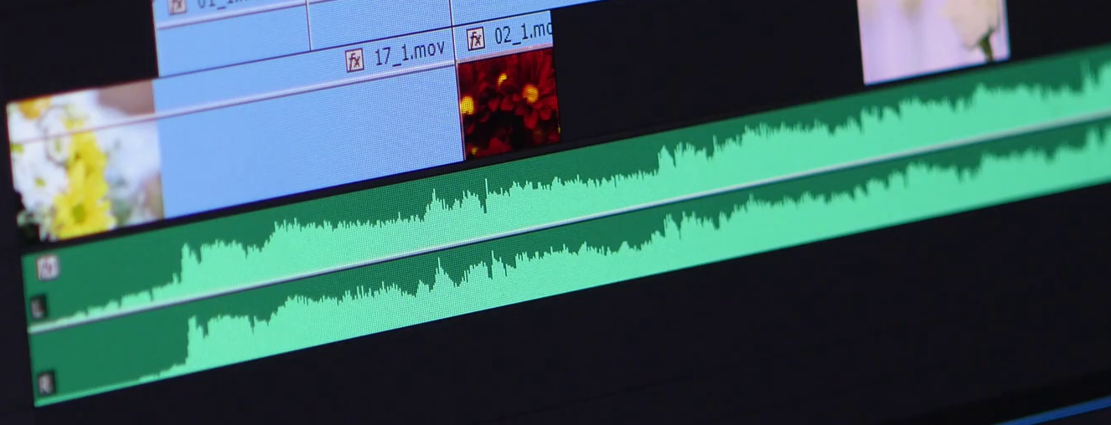
BETTER THAN EXISTING ALGORITHM
High resolution rotation detection
Detect long pattern of rotation including time used in each step
Pattern is hard to Copy

Slide 14
BETTER THAN DEEP LEARNING IN TERMS OF
Use small data.
Use less computational resources.
Don’t need to train before use, just save your pattern in order to verify.

Slide 15
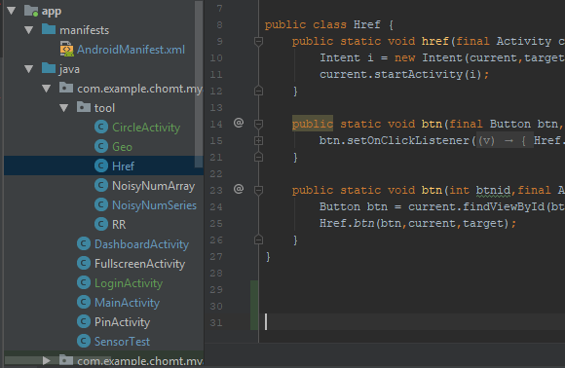
CODE REUSEABILITY

Slide 16
THANK YOU FOR YOUR ATTENTION
Best regards, csk team

